Slide 1

Rationale
Introduction to Windows Store App Development Using HTML5 and JavaScript
Computer science is a field of study that deals with solving a variety of problems by using computers.
  To solve a given problem by using computers, you need to design an algorithm for it.
Multiple algorithms can be designed to solve a particular problem.
An algorithm that provides the maximum efficiency should be used for solving the problem.
  The efficiency of an algorithm can be improved by using an appropriate data structure.
Data structures help in creating programs that are simple, reusable, and easy to maintain.
This module will enable a learner to select and implement an appropriate data structure and algorithm to solve a given programming problem.

Slide 2
Objectives
  In this session, you will learn to:
  Plan navigation for Windows Store apps
  Implement navigation in a Windows Store app
Notes:
2

Slide 3
Planning Navigation
  Designing the navigation of an app is an important activity that requires detailed planning.
  To help you perform this activity, Windows Store apps support various navigation patterns.
Let us view an animation, which explains the phases of app lifecycle
Notes:
3

Slide 4
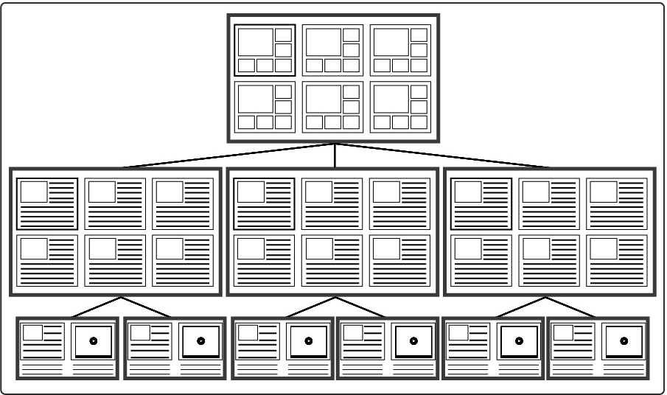
Hierarchical Navigation Pattern
  The hierarchical navigation pattern:
  Is also known as the Hub and Spoke model.
  Organizes the content of an app in a hierarchy, as shown in the following figure.
Notes:
4

Slide 5


Just a Minute
  Which one of the following pages consists of individual items within the category selected on the hub page?
    1. Blank
    2. Spoke
    3. Hub
    4. Details

Slide 6
Just a Minute (Contd.)
  Solution:
    2. Spoke

Slide 7
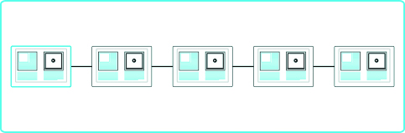
Flat Navigation Pattern
  The flat navigation pattern is suitable for apps that contain less amount of content spread across a small number of pages or tabs.
  All the pages of the app are organized at the same hierarchical level, as shown in the following figure.
  The App bar can be used for navigating between various pages in the app.
Notes:
7

Slide 8
Implementing Navigation
  To allow navigation among the pages of an app, you need to link the pages.
  You also need to pass information from one page to another so that the users can access the information provided on one page from the other pages of the app.
Notes:
8
Explain the scenario.

Slide 9
Navigating from One Page to Another
  Multi-page navigation:
  Each page has its own set of HTML content, JavaScript functions, and CSS to apply styles.
  The most commonly-used method to navigate from one page to another by using hyperlinks.
  The following code snippet will navigate you to the Page2.html file in an app:
      <a href="ms-appx:///Page2.html">Go to the Second page</a>
Notes:
9

Slide 10

Navigating from One Page to Another (Contd.)
  Single-page navigation:
  A single page is used whose content is replaced with the content of the other pages when you navigate between the pages.
  Several project templates, such as Grid App, Split App, and Navigation App, can be used for this navigation.
  The following figure shows how the single-page navigation works.
Notes:
10

Slide 11
Navigating from One Page to Another (Contd.)
  While using the single-page navigation, the PageControlNavigator control is used in the main page, default.html, as shown in the following code snippet:
    <body>
    <div id="contenthost" data-win-control
    ="Application.PageControlNavigator"
    data-win-options="{home:
    '/pages/home/home.html'}">
    </div>
    </body>
Notes:
11

Slide 12
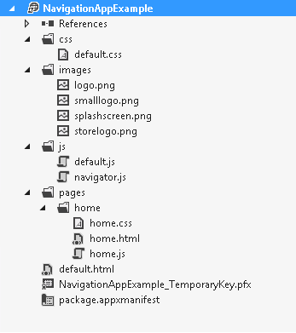
Navigating from One Page to Another (Contd.)
  When you use the Navigation App template for creating a navigation app, it adds various files in the Solution Explorer window of your project, as shown in the following figure.
Notes:
12
Explain the various files present in the Solution Explorer.

Slide 13
Navigating from One Page to Another (Contd.)
  To implement navigation among the pages of an app created by using the Navigation App template:
  You can use the following functions provided by the WinJS.Navigation namespace:
WinJS.Navigation.navigate()
WinJS.Navigation.back()
WinJS.Navigation.forward()
Notes:
13

Slide 14
Navigating from One Page to Another (Contd.)
  The WinJS.Navigation.navigate() function:
  Allows a user to navigate from the current page to any other page of the app.
  Returns a promise that will indicate whether the navigation to a specified page is successful or not.
  The following code snippet allows navigation to Page2.html page:
    WinJS.Navigation.navigate("/pages/Page2/Page2.html");
Notes:
14

Slide 15
Navigating from One Page to Another (Contd.)
  The WinJS.Navigation.back() function:
  Allows a user to navigate backward from the current page of the app in the navigation history.
  Accepts an integer parameter, which defines the number of pages to go back in the navigation history.
  The following code snippet allows navigation two pages back in navigation history:
    WinJS.Navigation.back(2);
Notes:
15

Slide 16
Navigating from One Page to Another (Contd.)
  The WinJS.Navigation.forward() function:
  Allows a user to navigate from any of the previous pages to the next pages in the navigation history.
  Accepts an integer parameter, which specifies the number of pages to go forward in the navigation history.
  The following code snippet allows navigation two pages forward in navigation history:
    WinJS.Navigation.forward(2);
Let us look at an example, which implements navigation in an app
Notes:
16

Slide 17
Just a Minute
  Which one of the following functions allows a user to navigate from any of the previous pages to the next pages in the navigation history?
    1. WinJS.Navigation.navigate()
    2. WinJS.Navigation.back()
    3. WinJS.Navigation.forward()

Slide 18
Just a Minute (Contd.)
  Solution:
    3. WinJS.Navigation.forward()

Slide 19
Summary
  In this session, you learned that:
  The commonly-used navigation patterns in the Windows Store apps are:
    Hierarchical
    Flat
  The WinJS.Navigation.navigate() function allows a user to navigate from the current page to any other page of the app.
  The WinJS.Navigation.back() function allows a user to navigate backward from the current page of the app in the navigation history.
  If a user has navigated backward, the WinJS.Navigation.forward() function allows a user to navigate from any of the previous pages to the next pages in the navigation history.
Notes:
19

Slide 20

Q&A

